Slide 1

University of Utah Athletics Women’s Soccer
MSIS Capstone Project Summer 2018

Slide 2
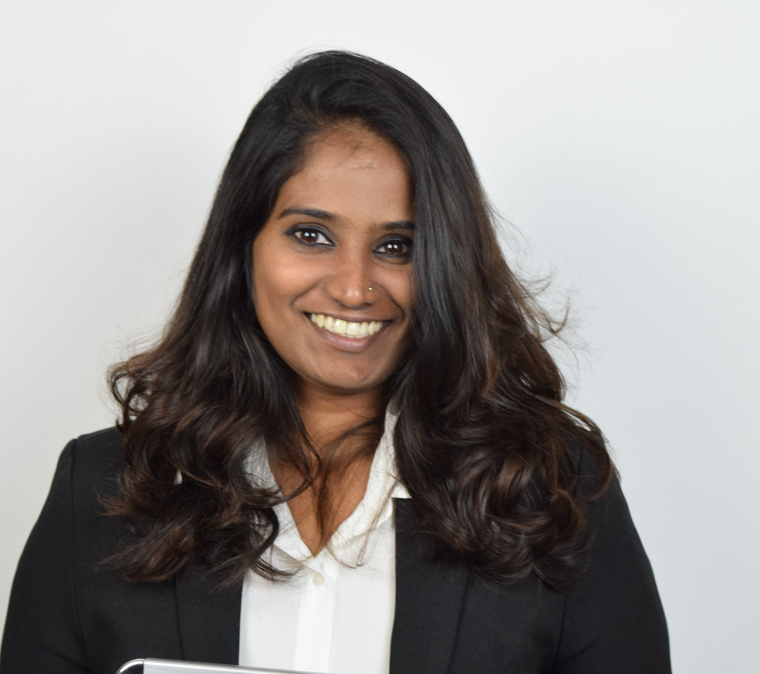
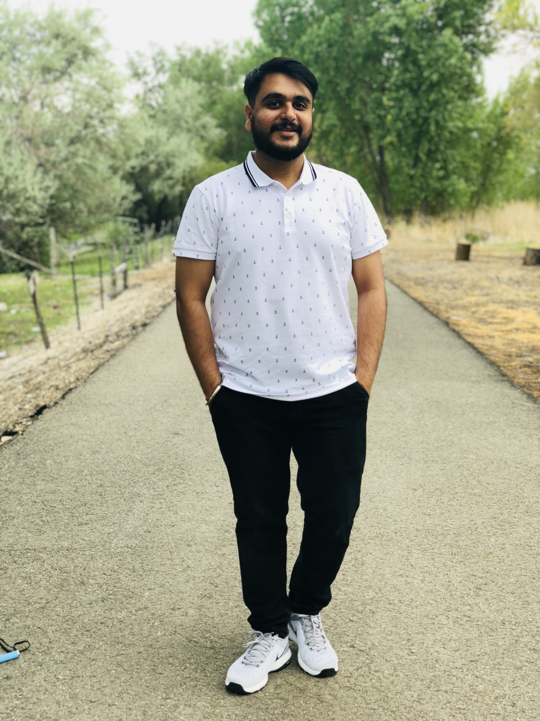
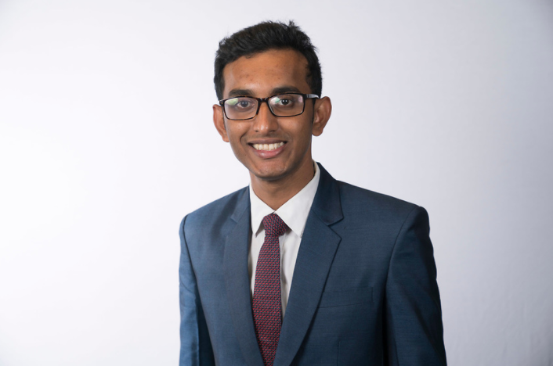
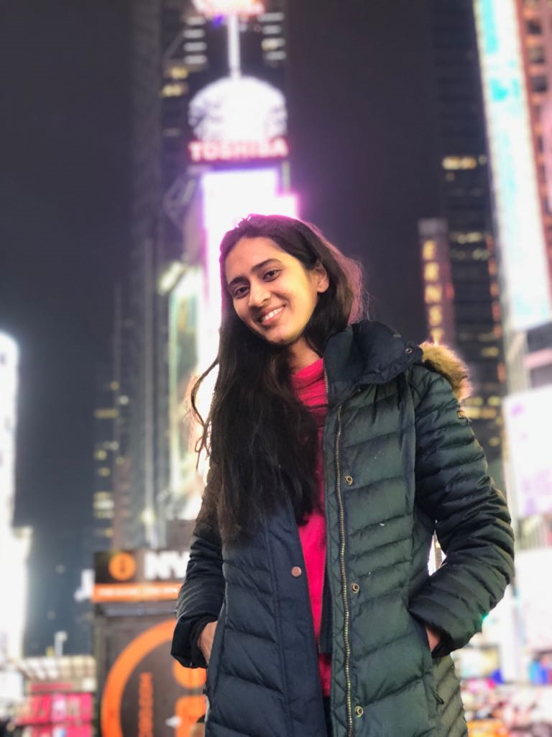
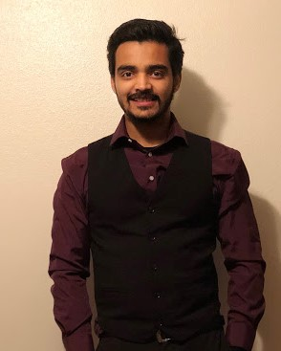
Team Members
ARPITA BANGERA
NISHIT SHETTY
DHAVAL SWALI
RASIKA LELE
ROMIT SHAH

Slide 3
Design and Develop Player Wellness Module
Design and Develop Player Injury Module
BUSINESS NEEDS
Visualize Injury Predictors
Automate Data Input Process For Roster
Classifying Player Injury Data

Slide 4

Roadblocks & Challenges
Current System Stopped Working
Inconsistent Software Version
No Current Data
But We Were Optimistic To

Slide 5
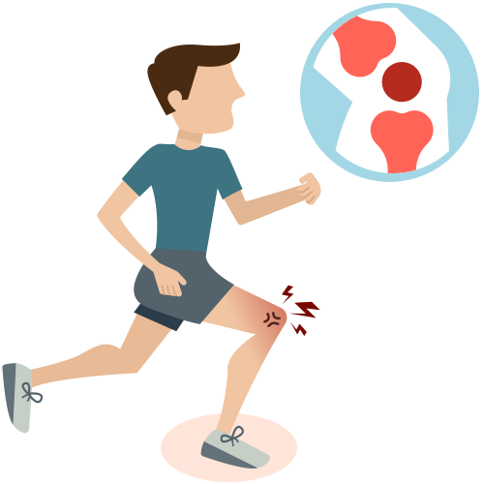

Model Features
Sleep Duration
Sleep Quality
Nutrition
Stress
Fatigue
Muscle-Soreness
Duration
TL
RPE
Athlete Duration
Last 7 Day TL
Predicts
INJURY

Slide 6
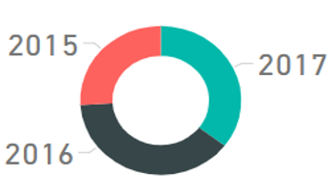
Visualizations
Count of Injury By Year

Slide 7
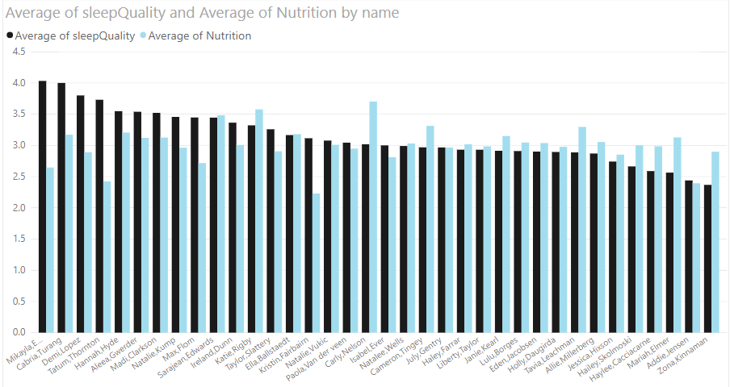
Visualizations
Average Sleep Quality & Average Nutrition By Name

Slide 8
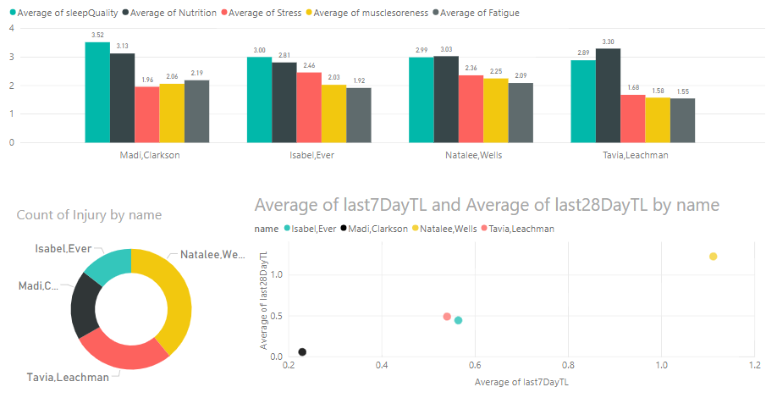
Average Sleep Quality, Nutrition, Stress, Muscle soreness, Fatigue By Name
Madi Clarkson
Isabel Ever
Natalee Wells
Tavia Leachman

Slide 9
Data classification Models
Decision Trees
Random Forest
MLP – Neural Nets
KNN

Slide 10
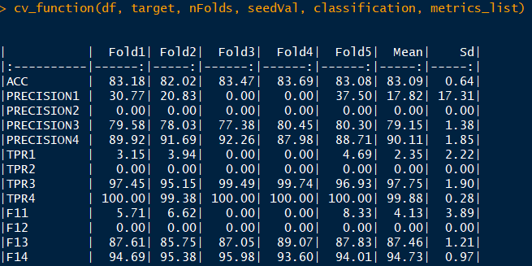
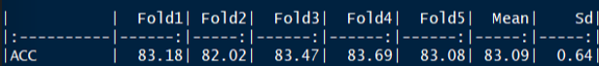
Performance Metrics: Decision Tree C5.0

Slide 11
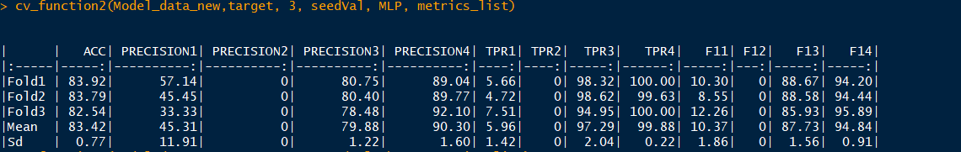
Performance Metrics: Neural Net MLP

Slide 12
Web App Modules
Notes:
Explain all the problems faced : oh no it’s a java error , mysql version issue, anguar package issue
User friendly and intuitive design
2 modules

Slide 13
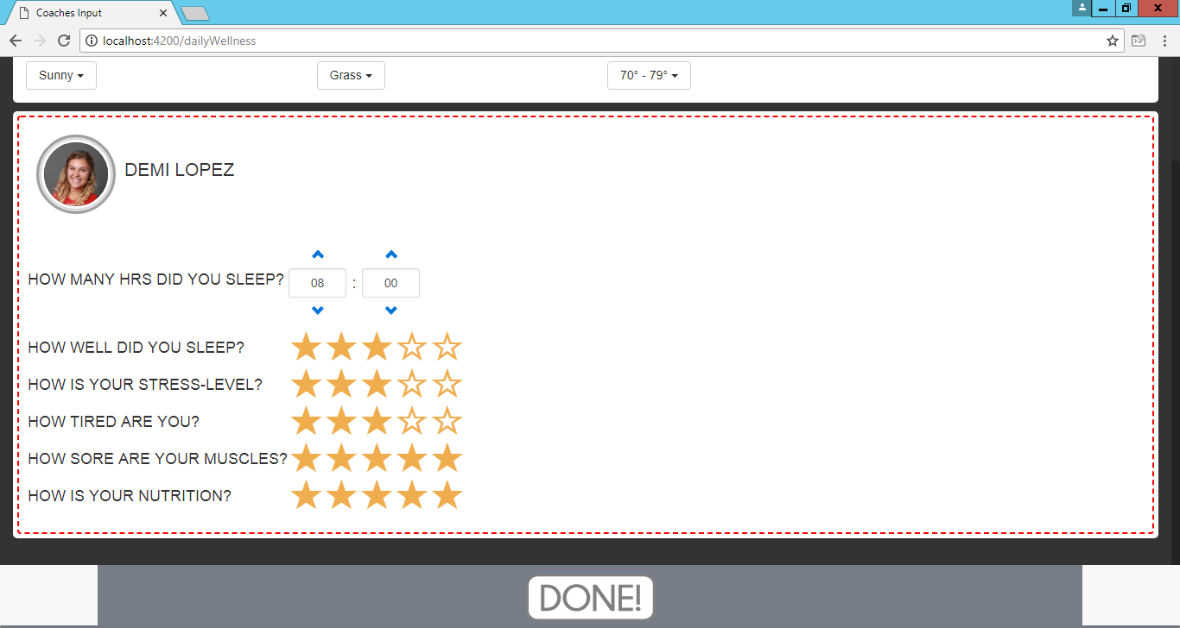
Player Wellness Module

Slide 14
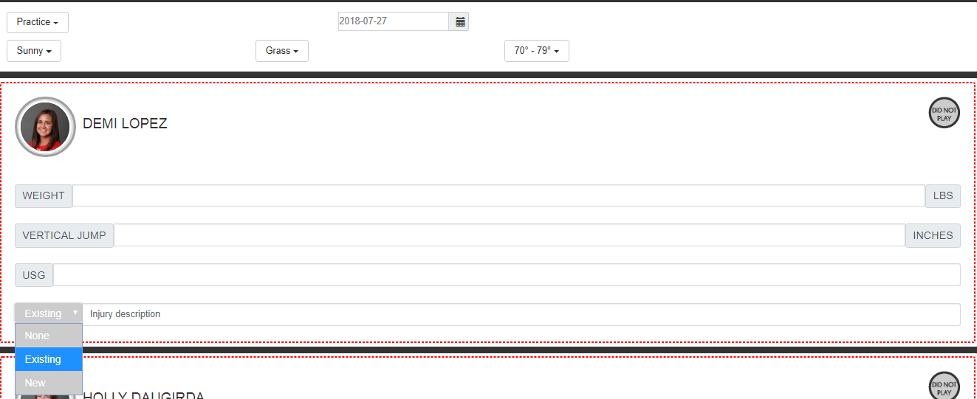
Player Injury Module

Slide 15
Future Scope
Automate Roster Process
Merge New Modules With Existing System
Generate Insights From New Injury And Wellness Data.

Slide 16
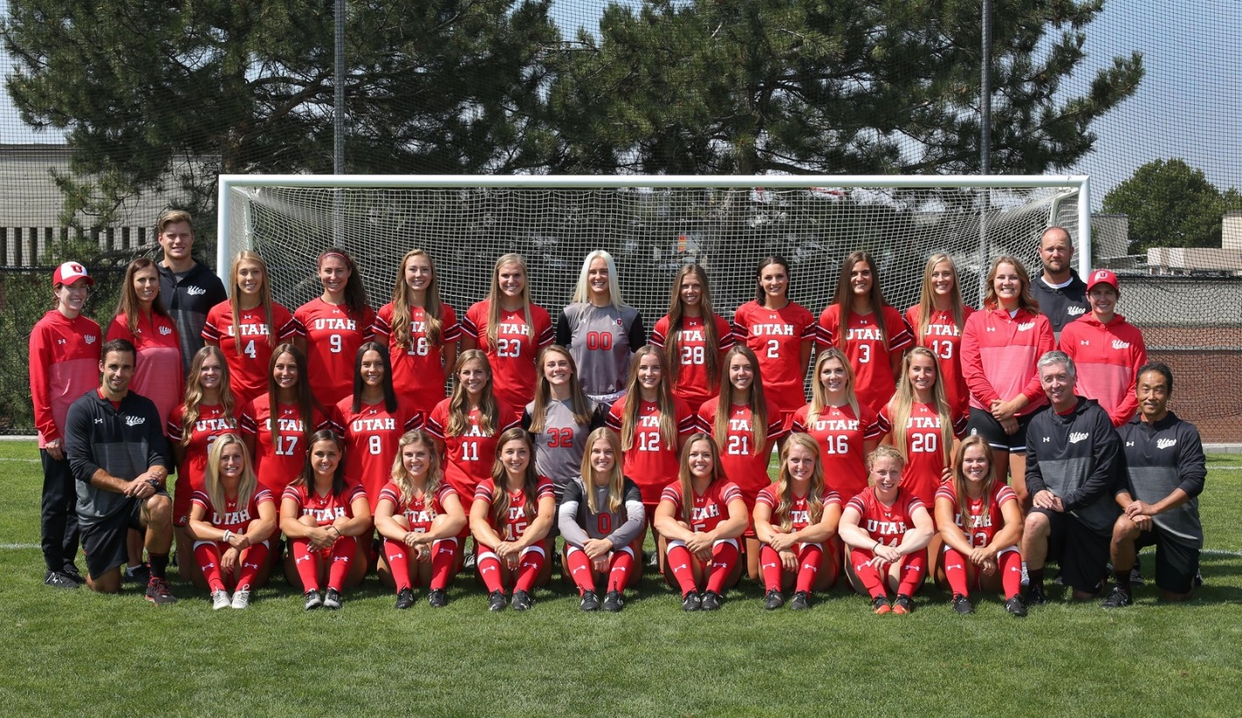
THANKS!
Feedback / Questions?
Credits :
University of Utah Women’s Soccer
Cody Lockling
Previous Project Team
Dave Norwood
Keith McClung

